Slide 1
Food For All
Sharing Hope, Sharing Meals!!

Slide 2
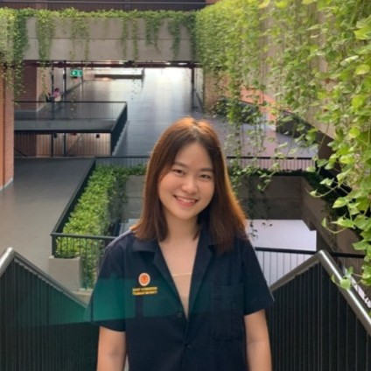
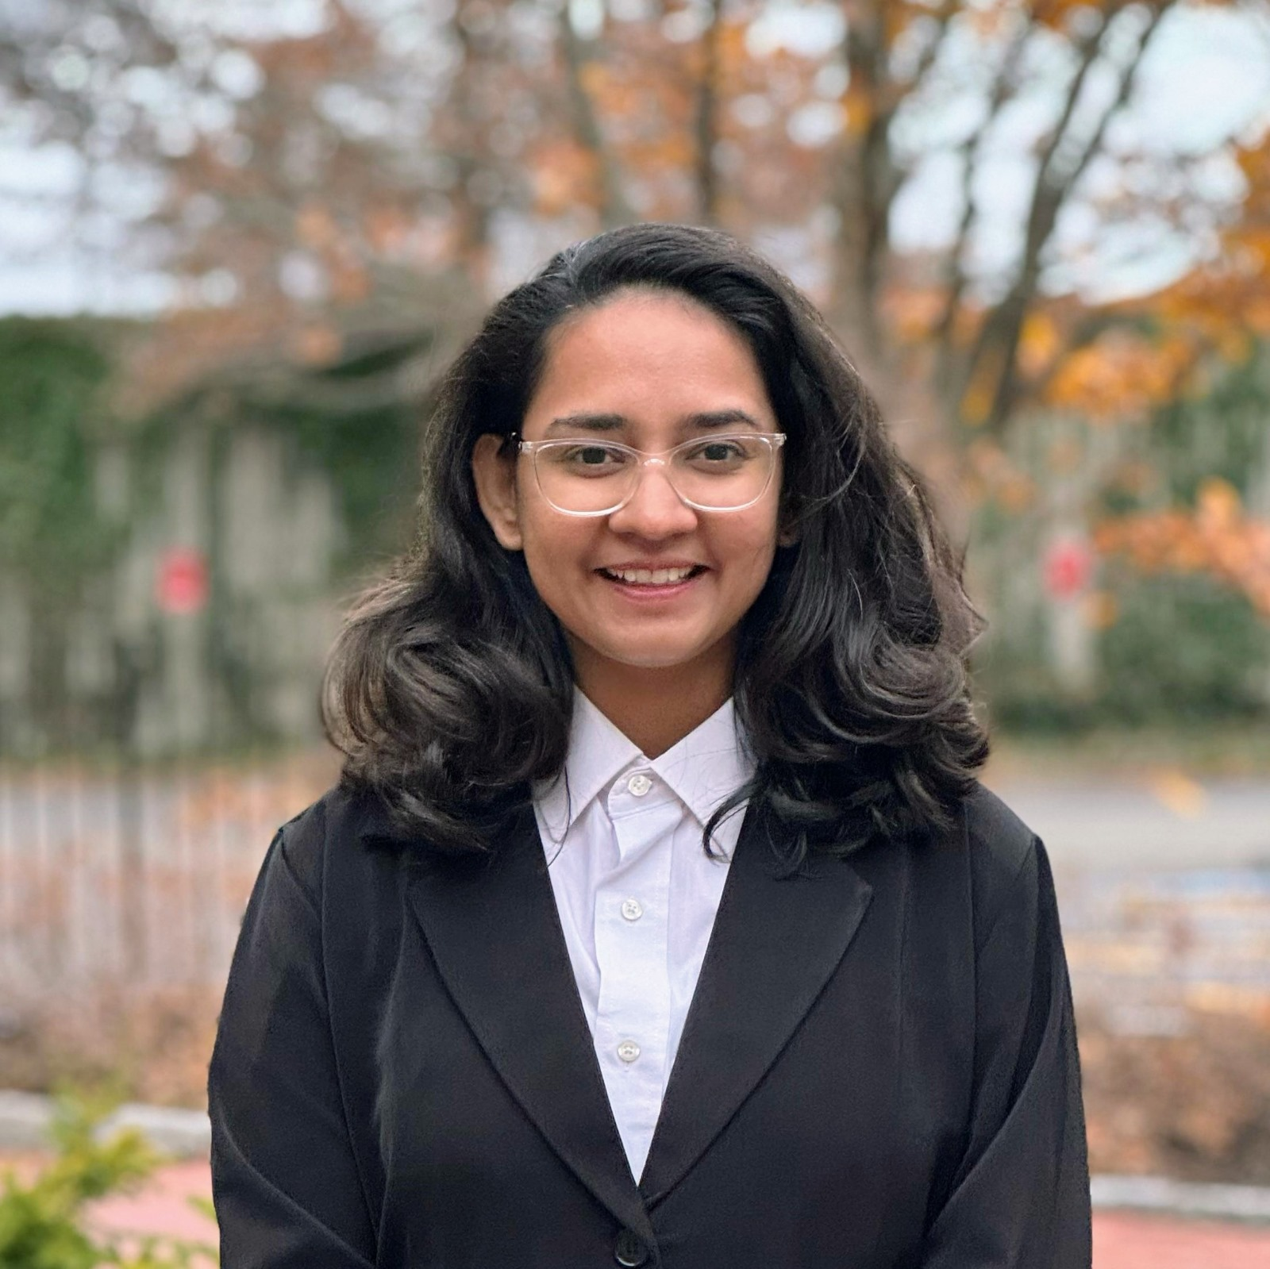


Meet The Team!!
Pinkaew Horputra
Foram Trivedi
Malav Hetalbhai Bhatt
Chaitanya Koribilli

Slide 3
The FoodForAll website is a platform designed to address food insecurity by connecting donors, volunteers, and recipients. Below, I’ll provide an overview of the website’s purpose, components, and user stories. The primary goal of the FoodForAll website is to facilitate the efficient distribution of food resources, encourage donations, and foster community engagement. Users can participate in various ways, contributing money, volunteering, and sharing their personal experiences.
Introduction

Slide 4
TECH STACK
Front end:
React
TypeScript
Redux
SCSS
Database:
MongoDB
Backend:
NodeJs
Express

Slide 5
Contents
1.Login/signup
2.Home Screen
3.Volunteer
4.Donate
5.Food bank locator

Slide 6
Features and Functionalities

Slide 7
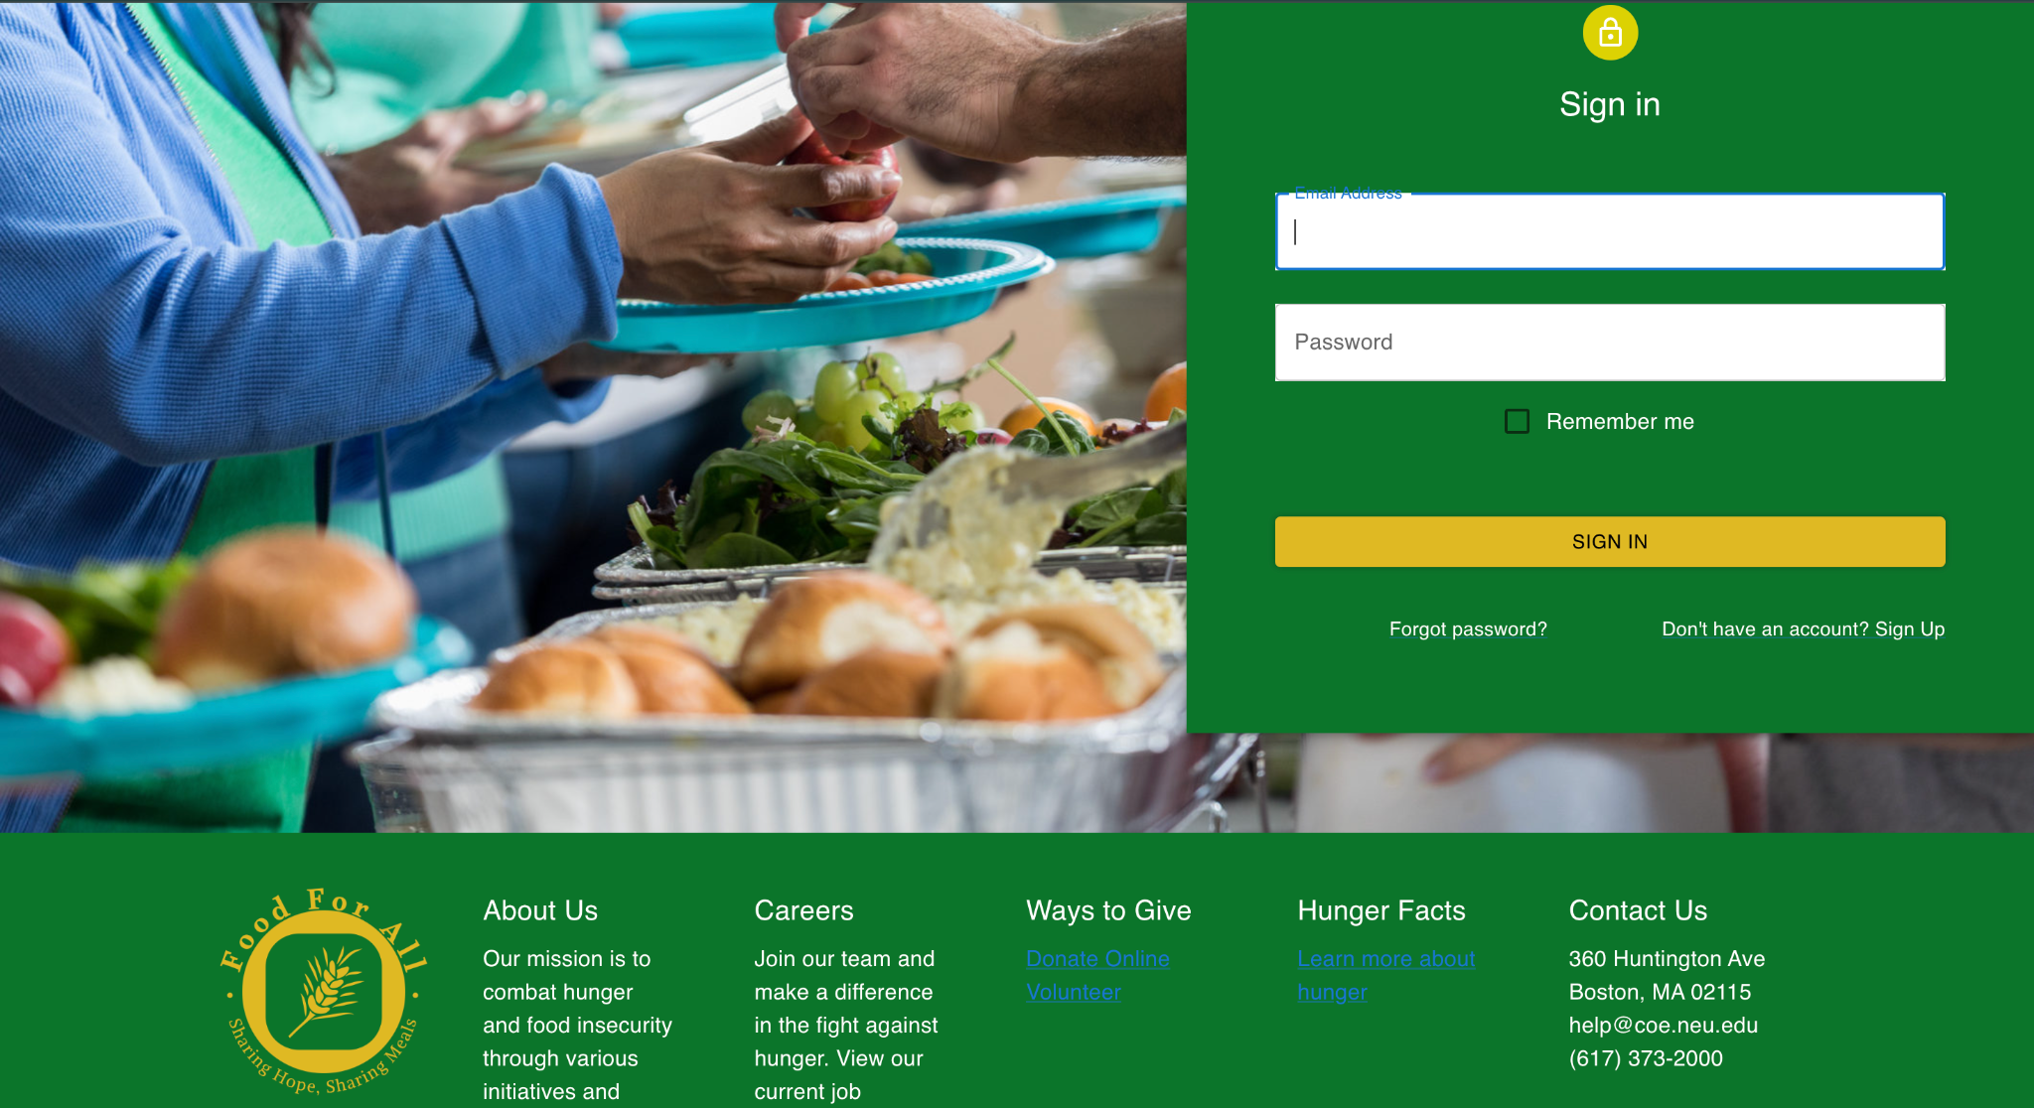
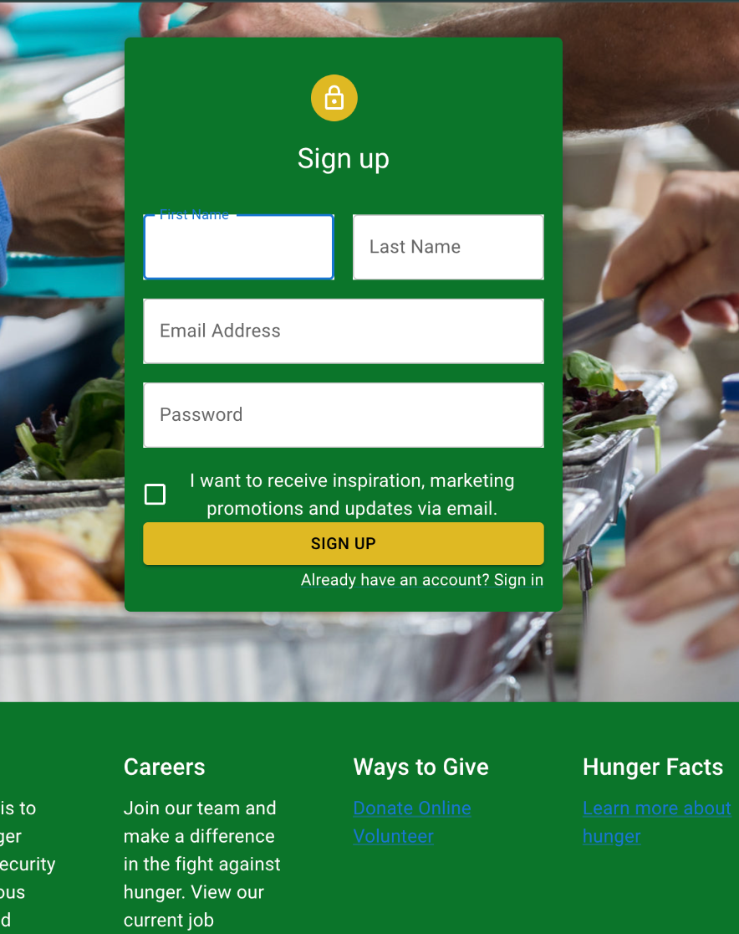
Login/Sign-up page

Slide 8
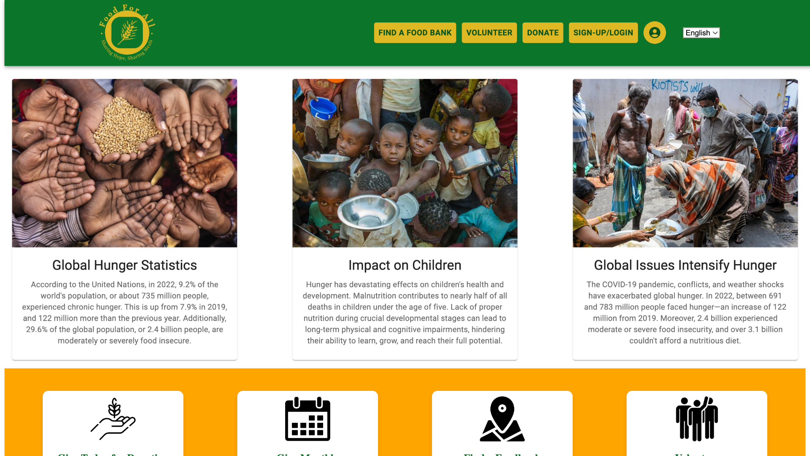
Home Page

Slide 9
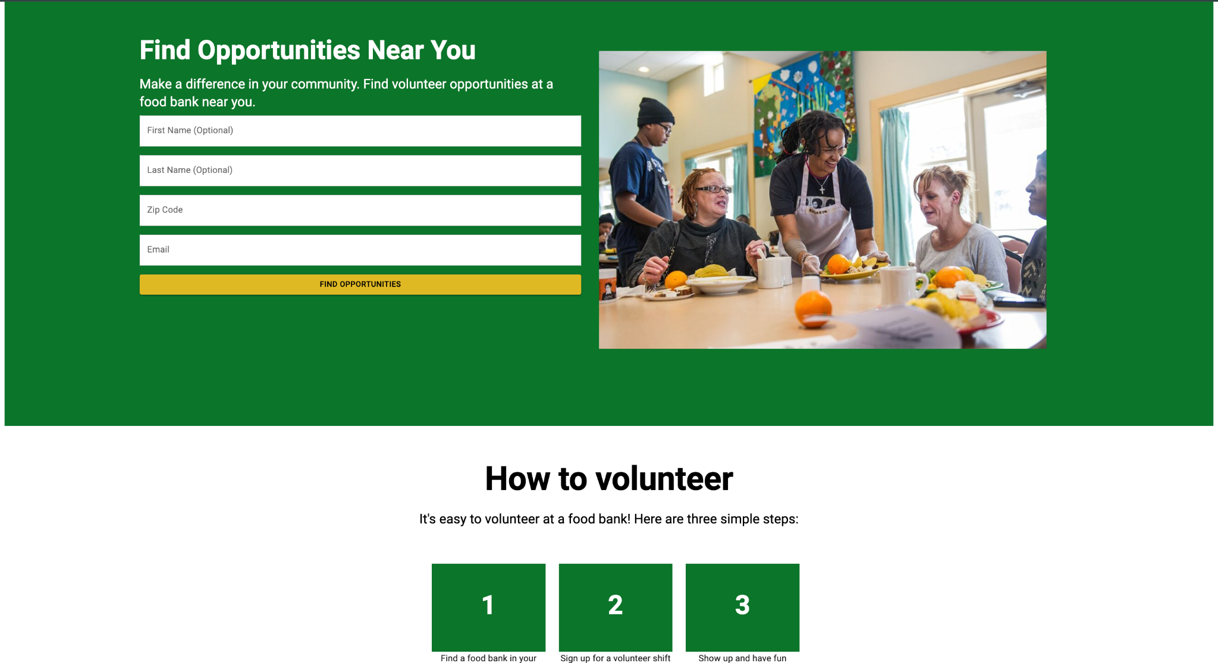
Volunteer Page

Slide 10
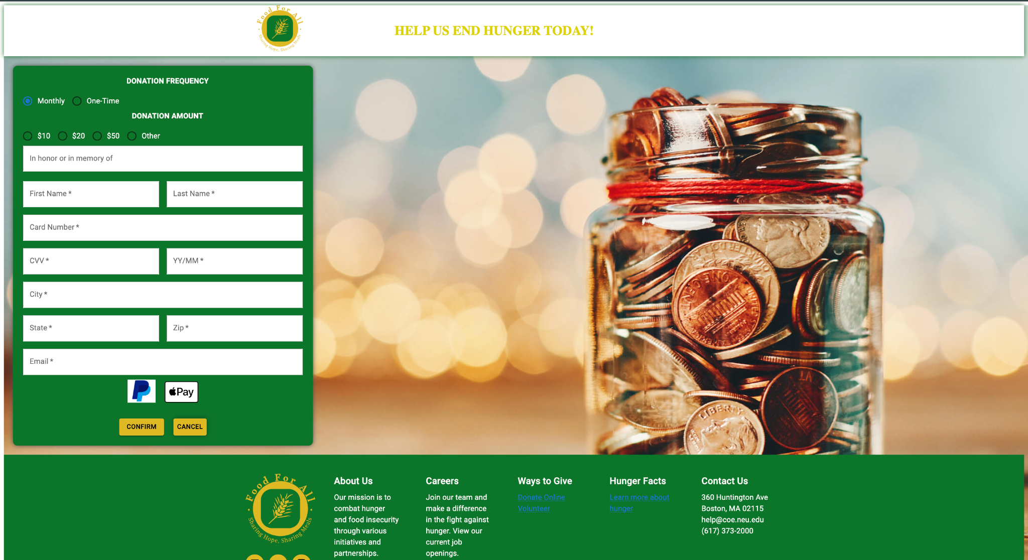
Donate Page

Slide 11
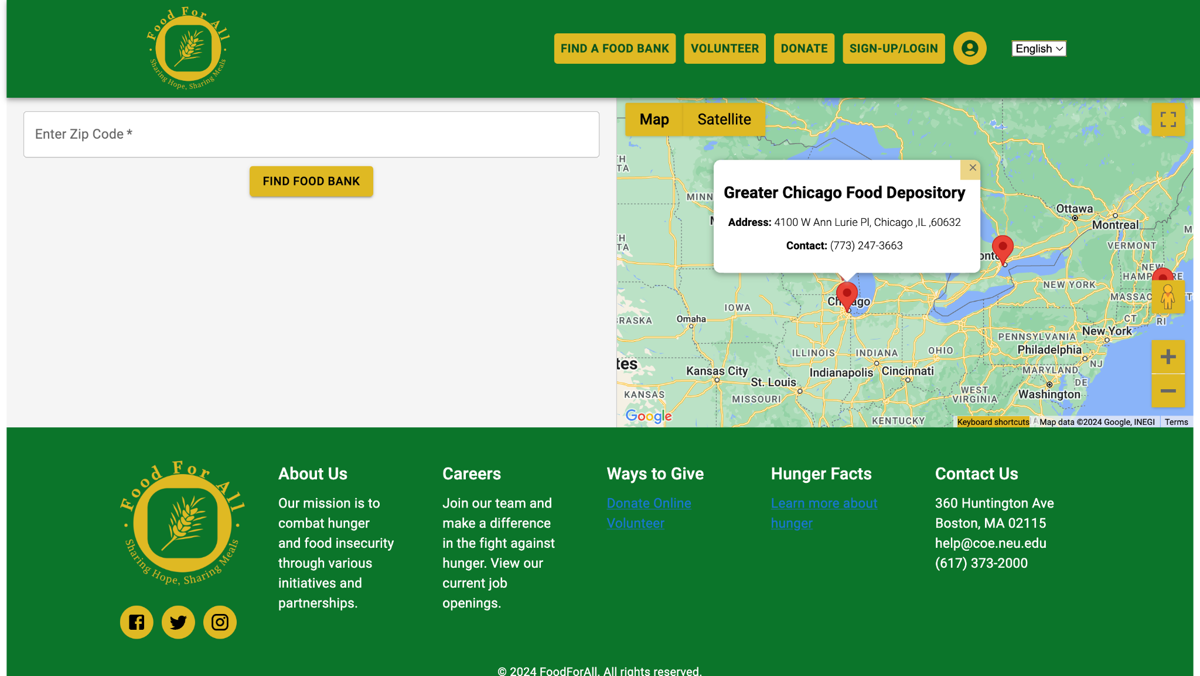
Food Bank Locator

Slide 12
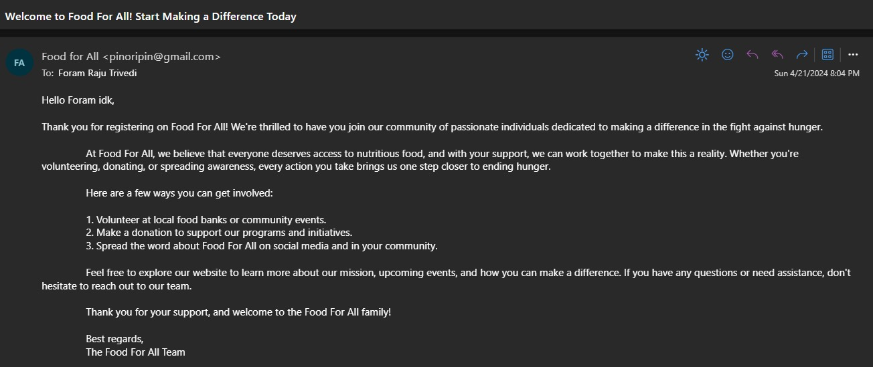
Additional Features and Functionalities
Signup Email Confirmation

Slide 13
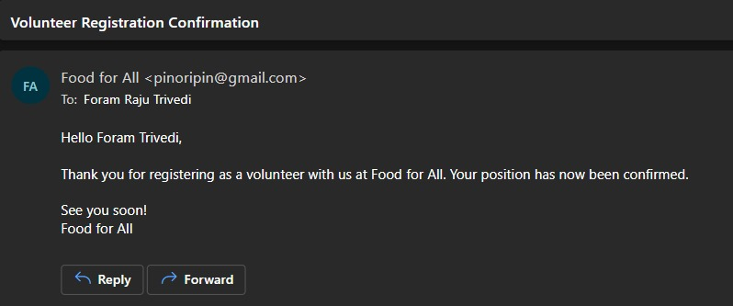
Additional Features and Functionalities
2. Volunteer Registration Email

Slide 14
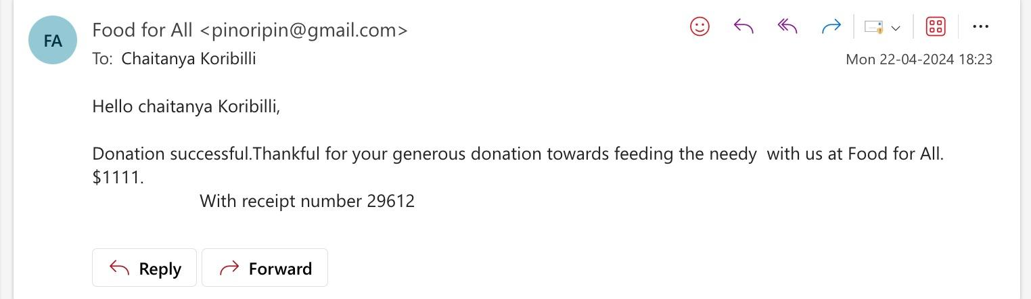
Additional Features and Functionalities
3. Donation Confirmation Email

Slide 15
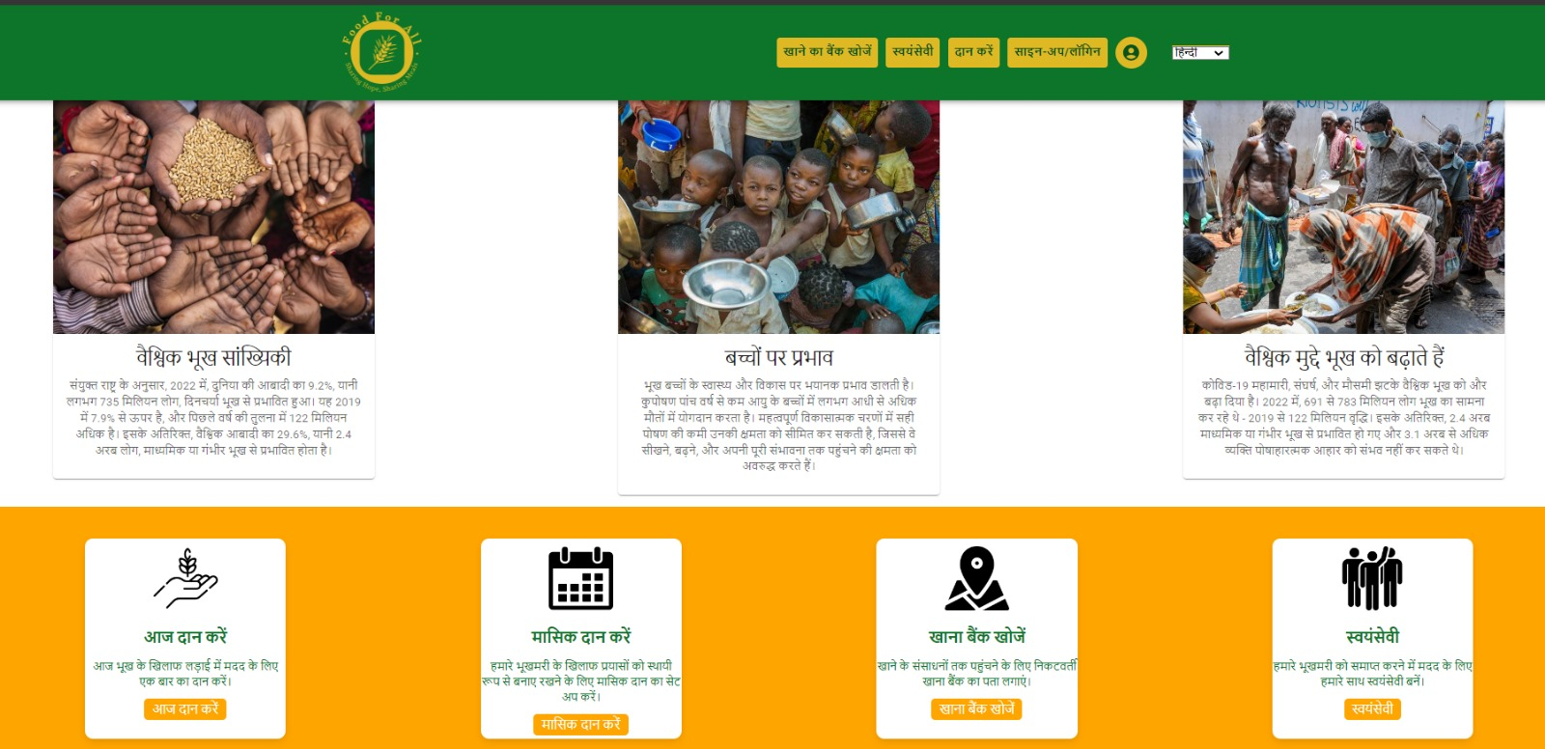
Additional Features and Functionalities
4. Added Internationalization in multiple Languages

Slide 16
Challenges Faced
Learning Curve with New Technologies:
Adapting to and mastering new technologies such as React, TypeScript, and Express within the constraints of a semester.and Express within the constraints of a semester.
Conducting peer learning sessions, leveraging online resources, and seeking guidance from instructors facilitated a quicker grasp of these technologies
Team Collaboration Dynamics:
Navigating the dynamics of team collaboration, communication, and task allocation within an academic setting.
Regular team meetings, collaborative tools, and a clear division of responsibilities fostered effective teamwork and project progress.

Slide 17
Future enhancements
Mobile App for android and iOS
Include the fund raising option with campaign creation
Donating food from the events happening in and around the zip code
Donating food from the restaurant chains and super markets like whole foods,stop and shop

Slide 18
Thank you!
-FoodForAll Team

